Slide 1
RFP Documents Review and Q&A

Slide 2
Review:
  Form 1 – Resilience Project & Subaward Notification Form
  Form 2 – Secretarial Eligible Entity Designation Form
Take a quick at:
  Form 3 – Environmental Questionnaire (NEPA)
  Form 4 – SF-424 Budget Justification Workbook
  Form 5 – Cost Match Commitment letter
  Form 6 – Appendix A-Performance Metrics to Evaluate Utility Resilience Investments
  Form 7 – Acknowledgement of Federal funds governed by DE-FOA-0002736-certification statement
  Form 8 – SF-LLL: Disclosure of Lobbying Activities (if applicable)
  Form 9 – Letters of Support (if applicable)

Slide 3
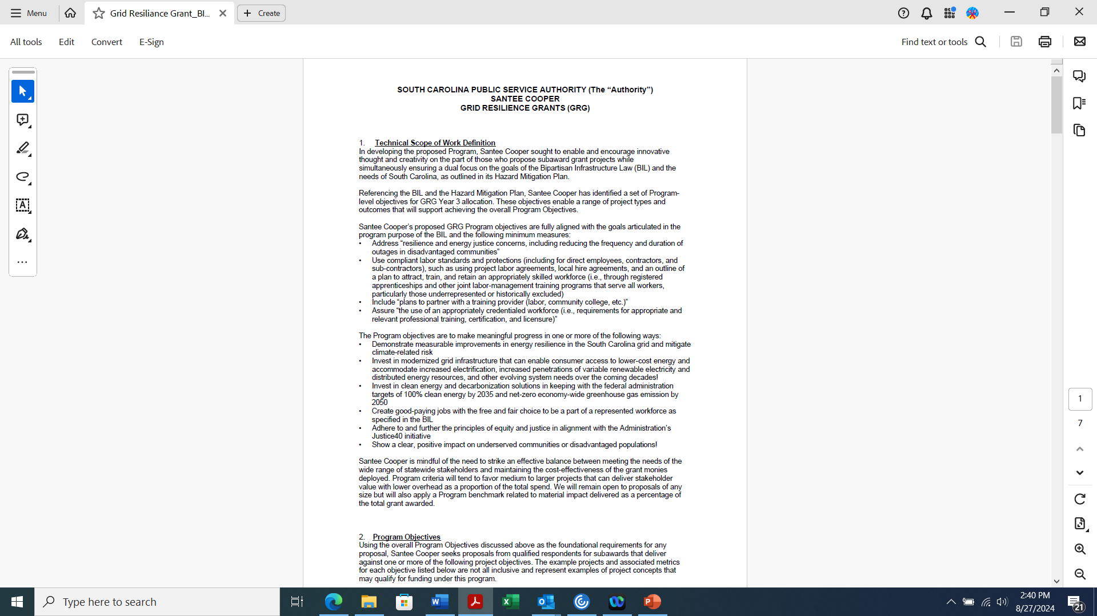
FY 24 GRG RFP
The RFP will be posted on the Grid Resilience Grant Program webpage by 5pm Friday, August 30^{th.}

Slide 4
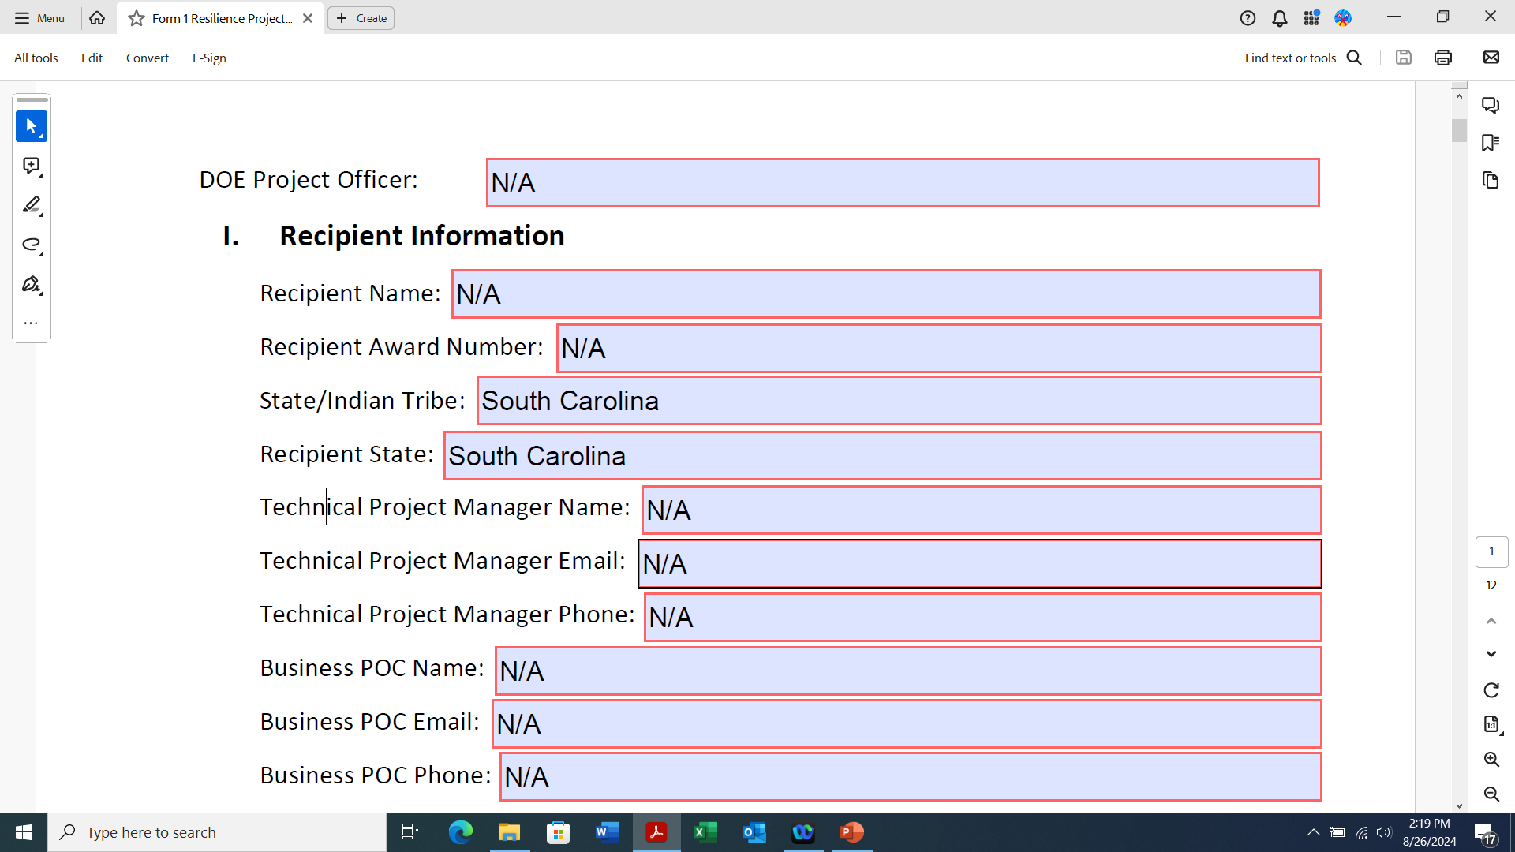
Form 1 - Resilience Project & Subaward Notification Form
Santee Cooper is the Recipient.
Applicants do not fill out Section I.

Slide 5
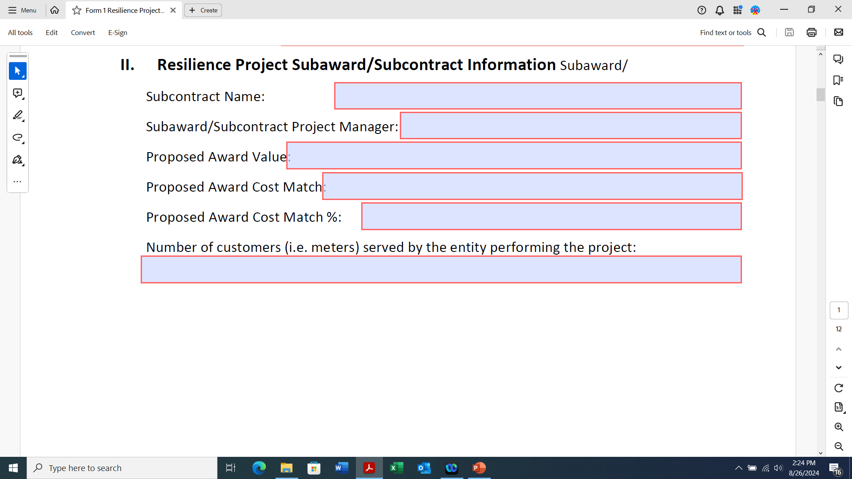
Form 1 - Section 2
Applicant is the Subaward/Subcontract
Applicant entity’s name and the person who will be responsible for the project’s goals and objectives.
Proposed Award Value = Federal Request
Proposed Award Cost Match = Applicant’s share
Proposed Award Cost Match % depends on size of entity

Slide 6
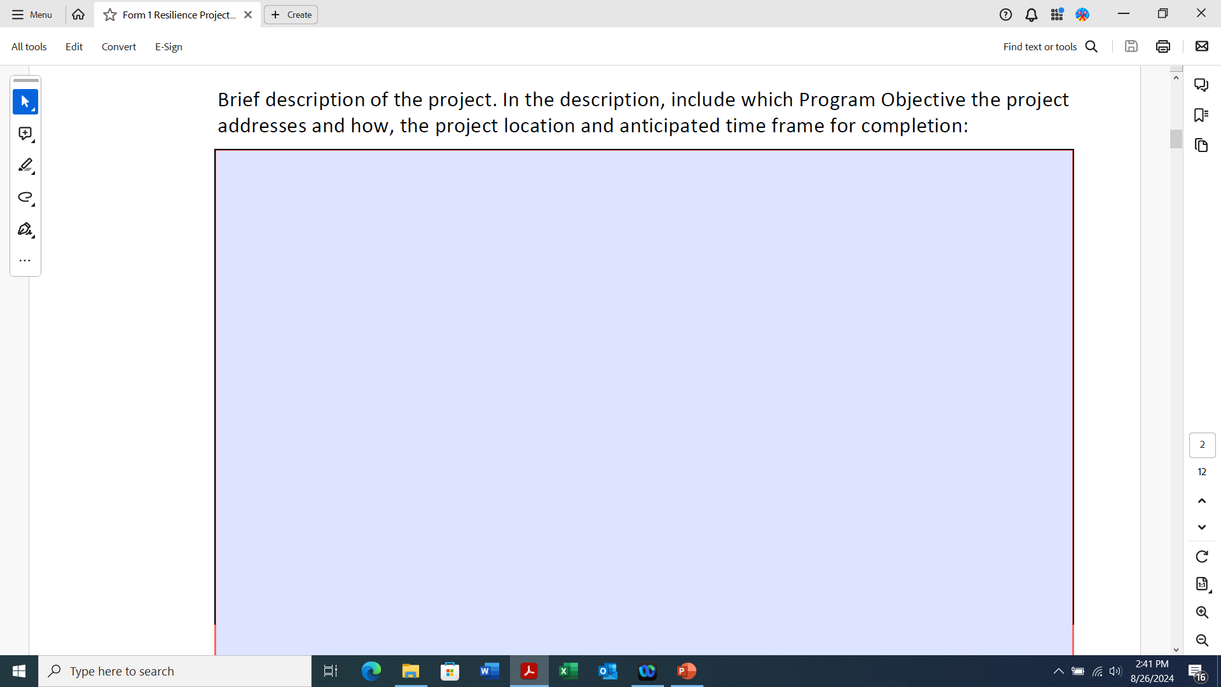
Form 1 - Section 2
The 4 program objectives are listed on pages 2-3 of the RFP along with examples of metrics for each project objective.

Slide 7
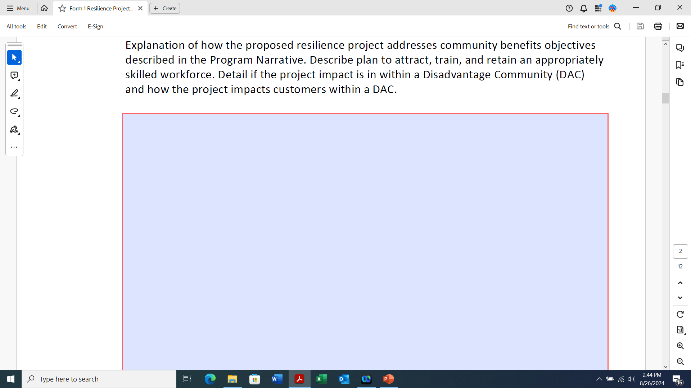
Form 1 - Section 2
Types of community benefits are on page 4 of the RFP.

Slide 8
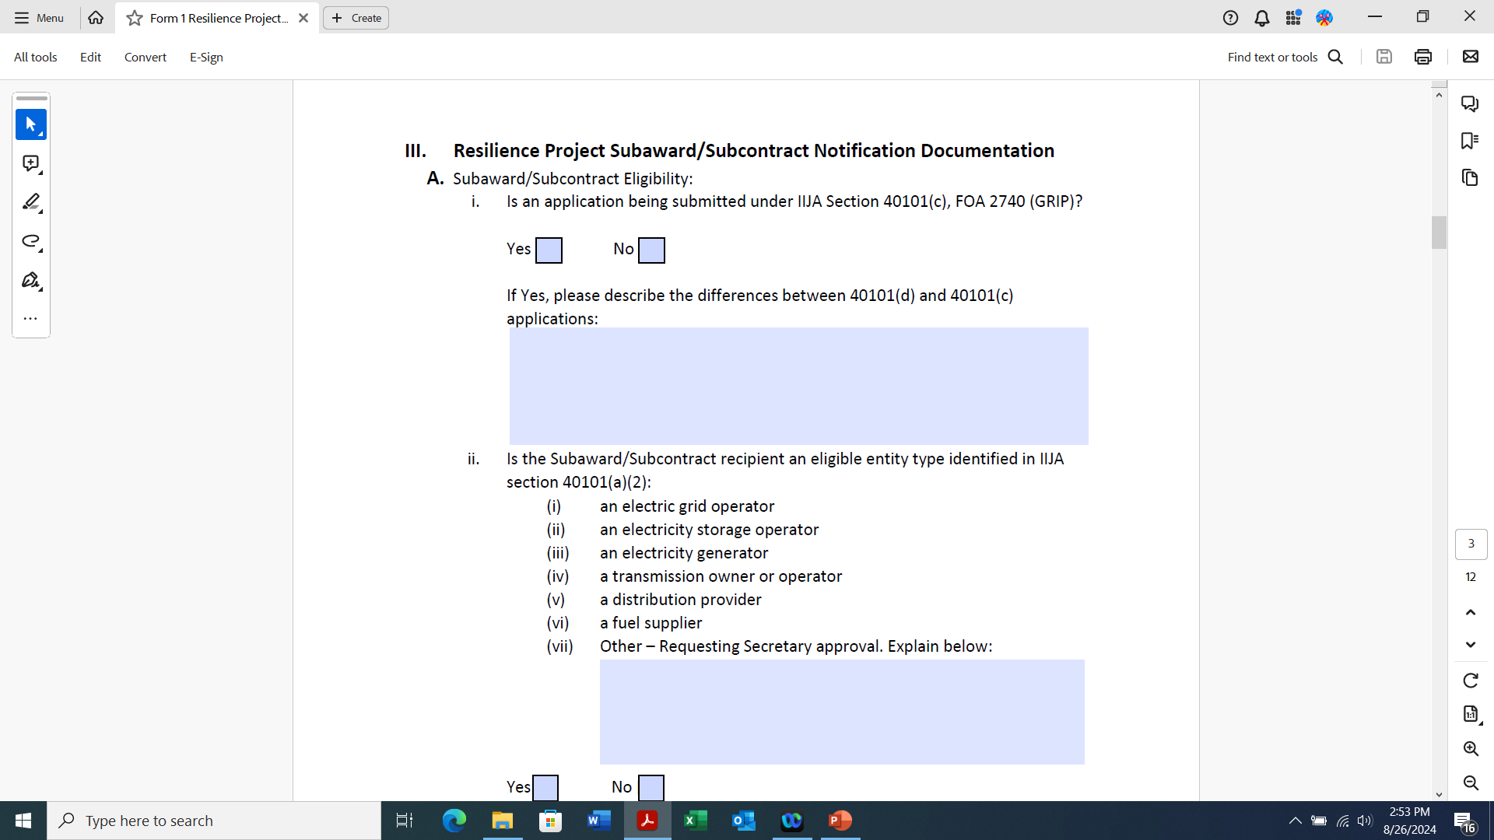
Form 1 - Section 3A
If you are also submitting this application under 40101(c), FOA 2740 GRIP check “yes”.

Slide 9
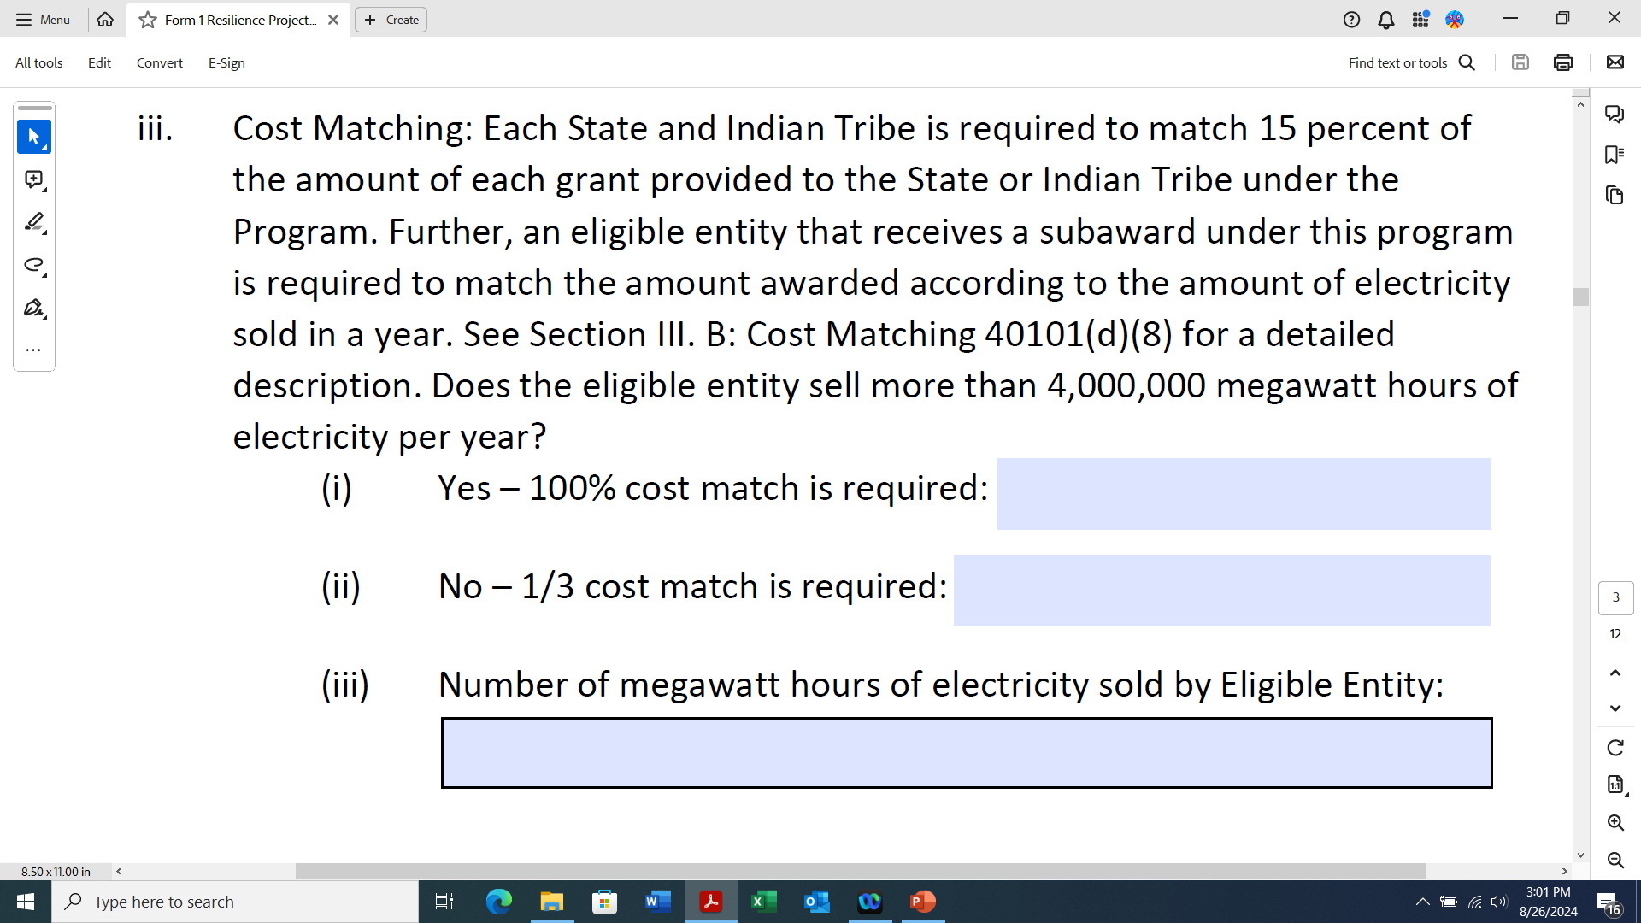
Form 1 - Section 3A
The cost match is calculated on the amount of the Federal request not the amount of the total project cost.
Notes:
Explain cost match. It is 25% of the total project cost.

Slide 10
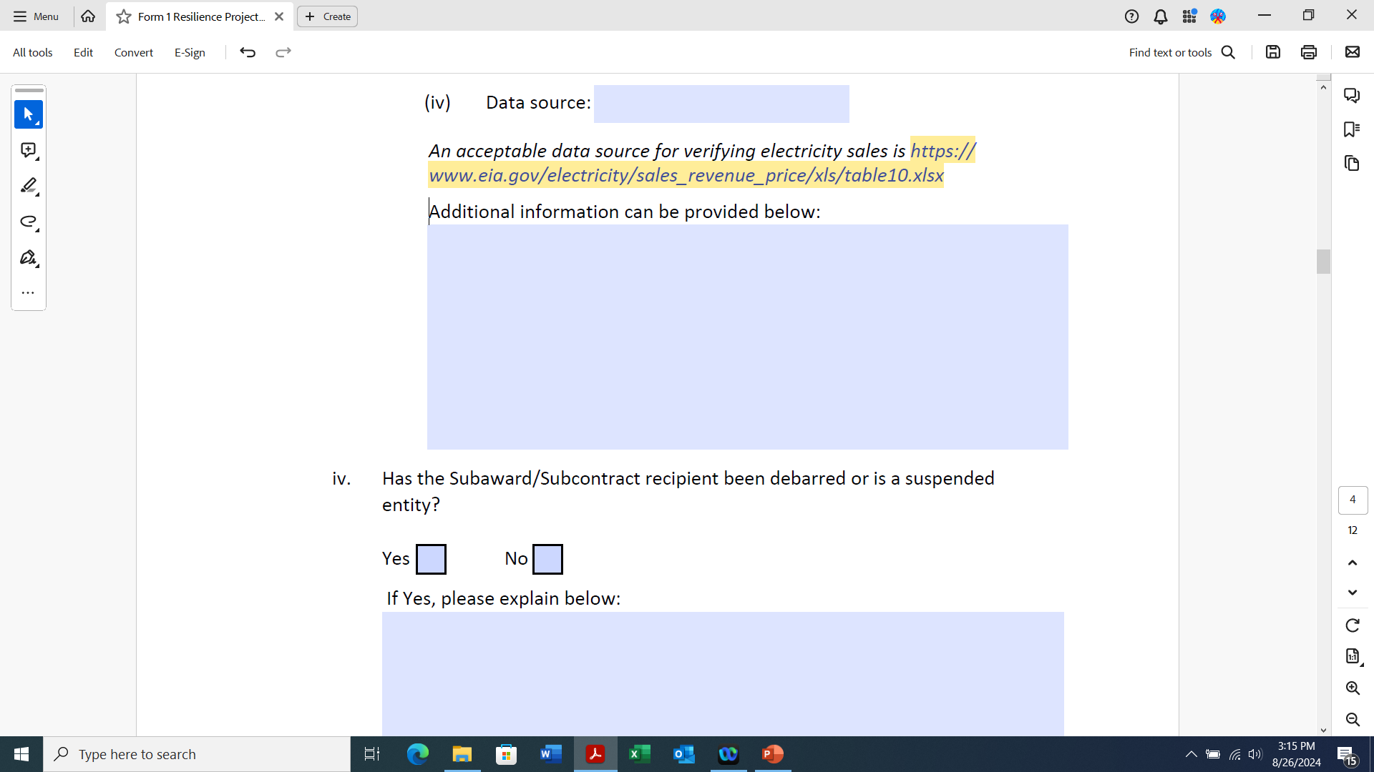
Form 1 - Section 3A
Debarred or suspended entities “may not conduct business with the Federal government as an agent or representative of other contractors or of participants in Federal assistance programs, nor may you act as an individual surety to other Government contractors”.

Slide 11
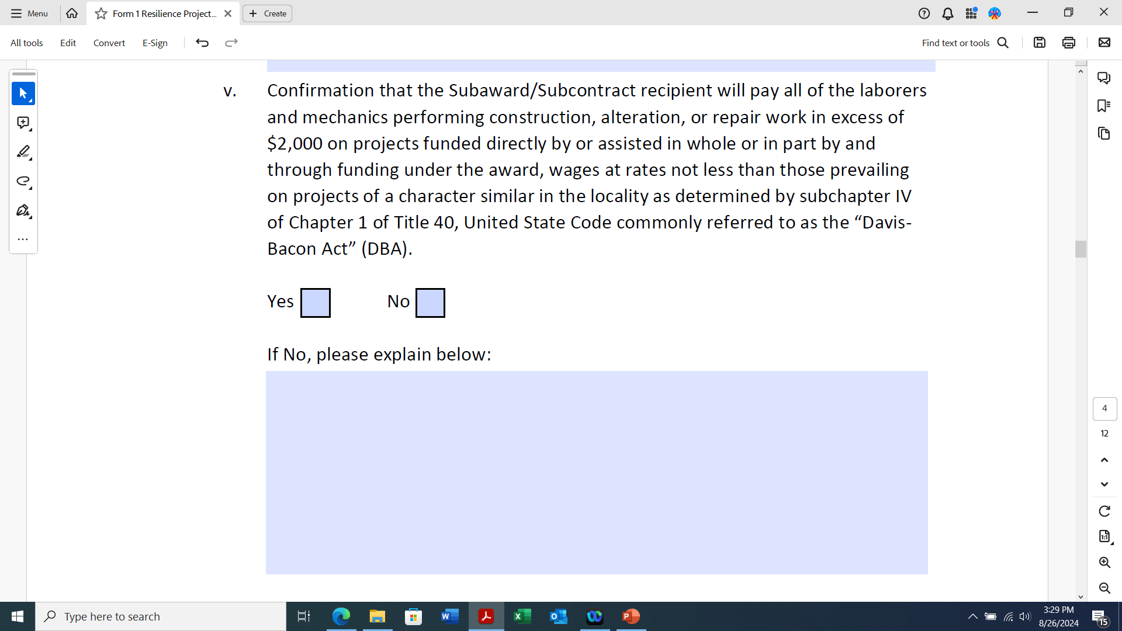
Form 1 - Section 3A
Davis-Bacon Act is listed under Section 7-Terms and Conditions on page 6 of the RFP.

Slide 12
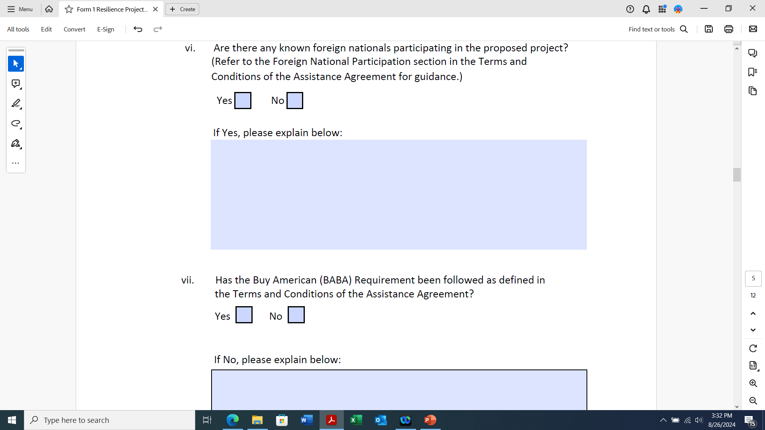
Form 1 - Section 3A
The Buy American requirement is listed under Section 7-Terms and Conditions on page 6 of the RFP.

Slide 13
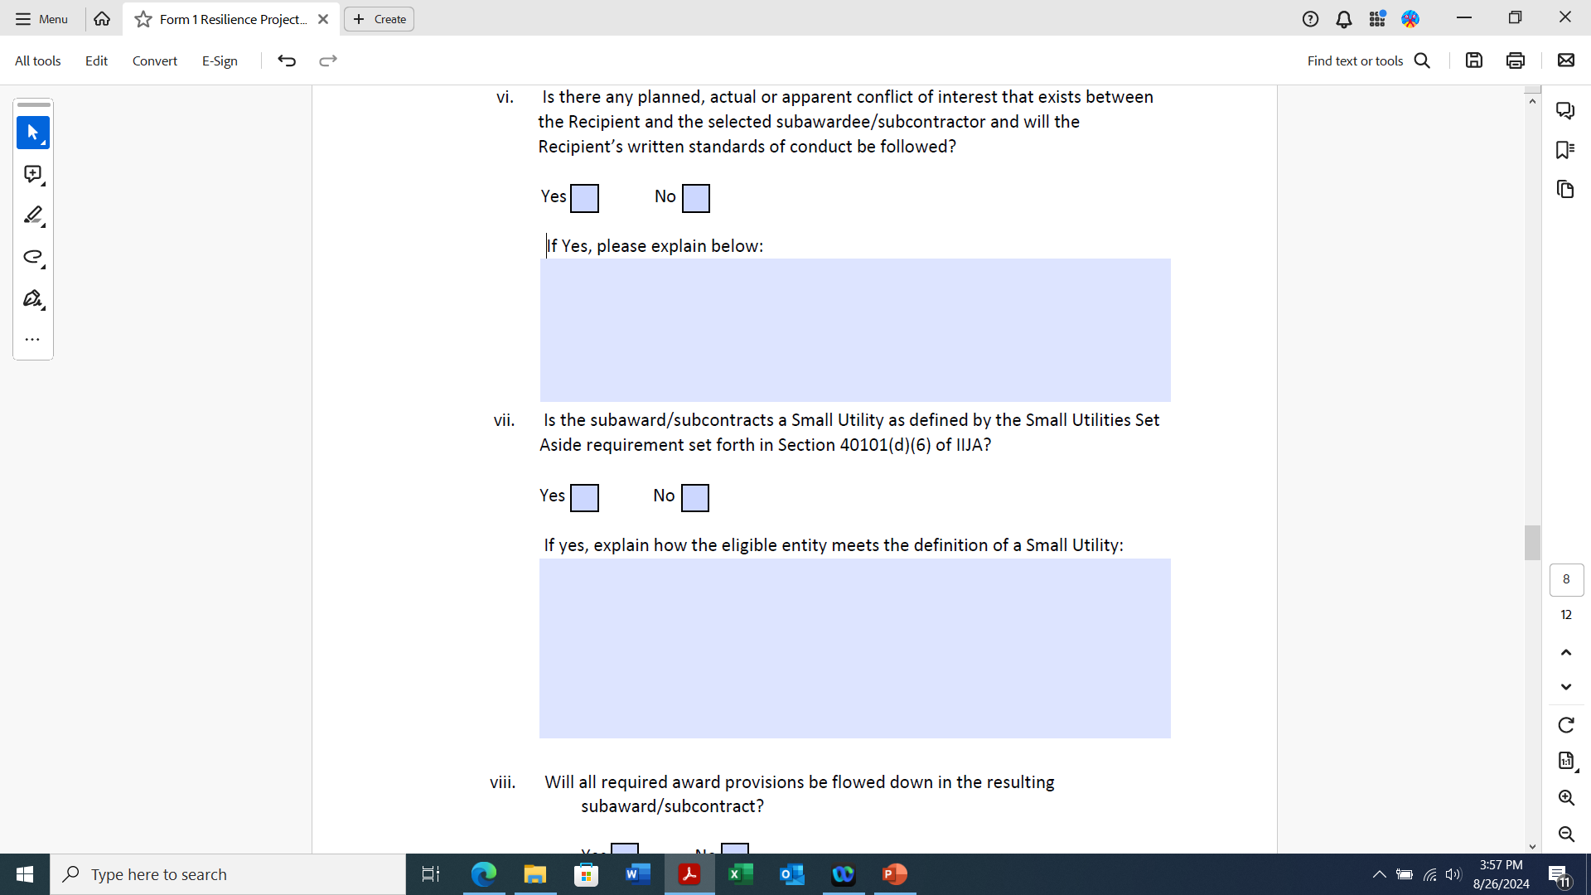
Form 1 - Section 3B
Small Utility = eligible entity that sells not more than 4,000,000 megawatt hours of electricity per year

Slide 14
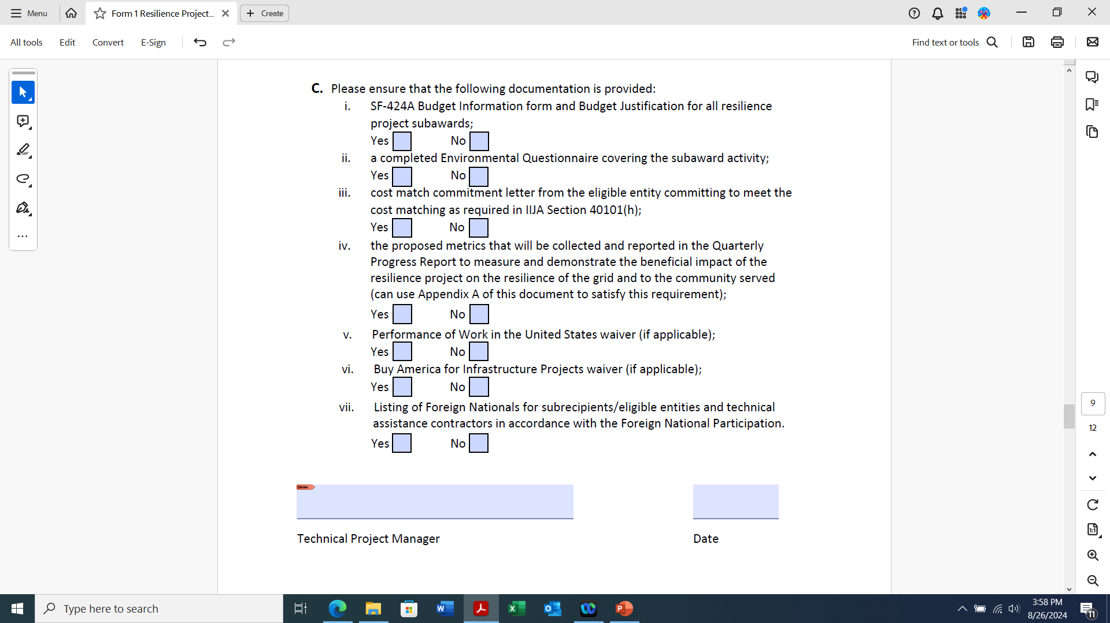
Form 1 - Section 3C
Notes:
Technical Project Manager should be the same person listed in Section 2.

Slide 15
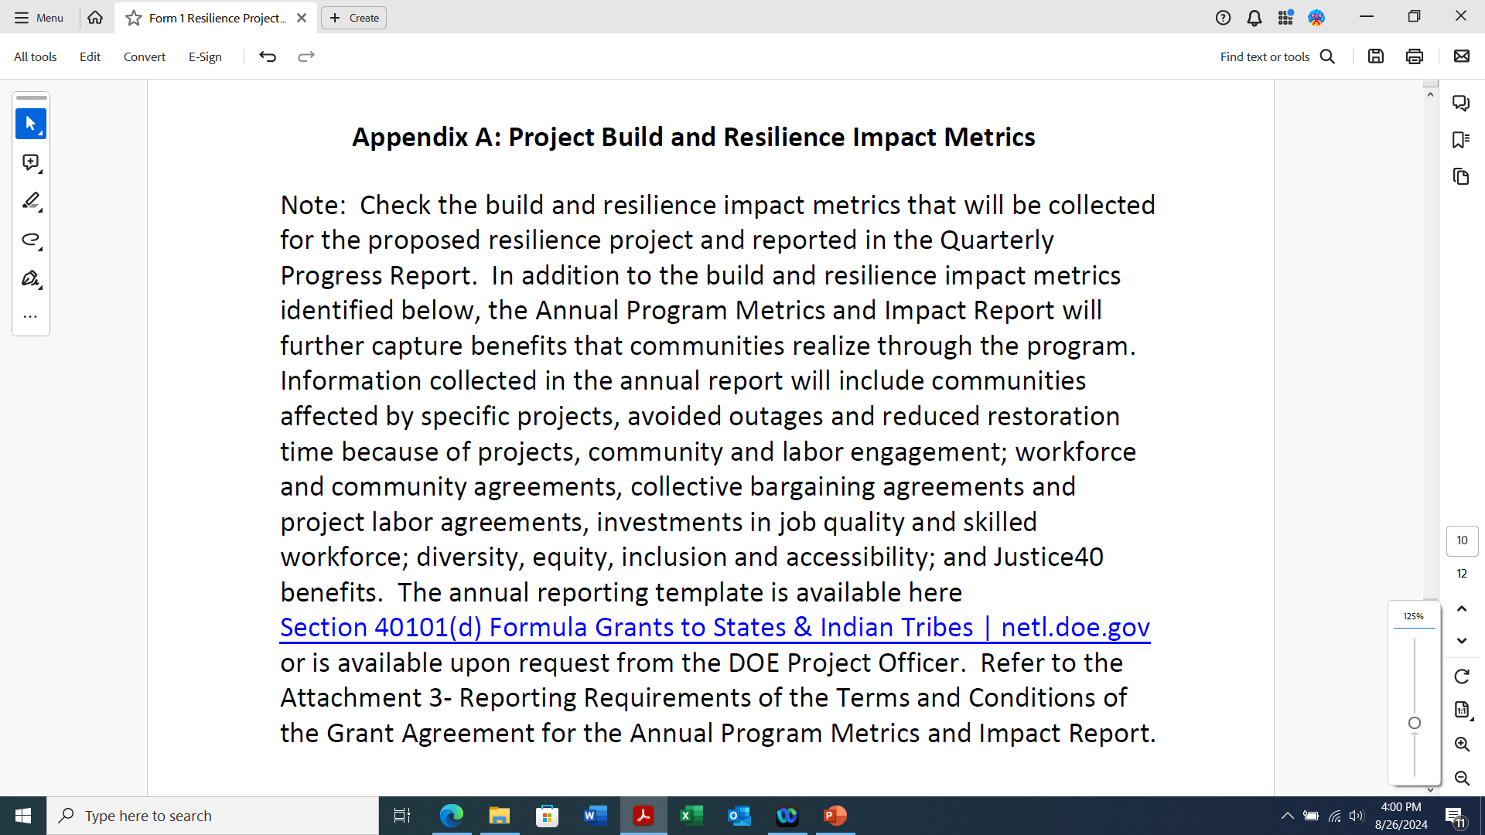
Form 1 - Appendix A

Slide 16
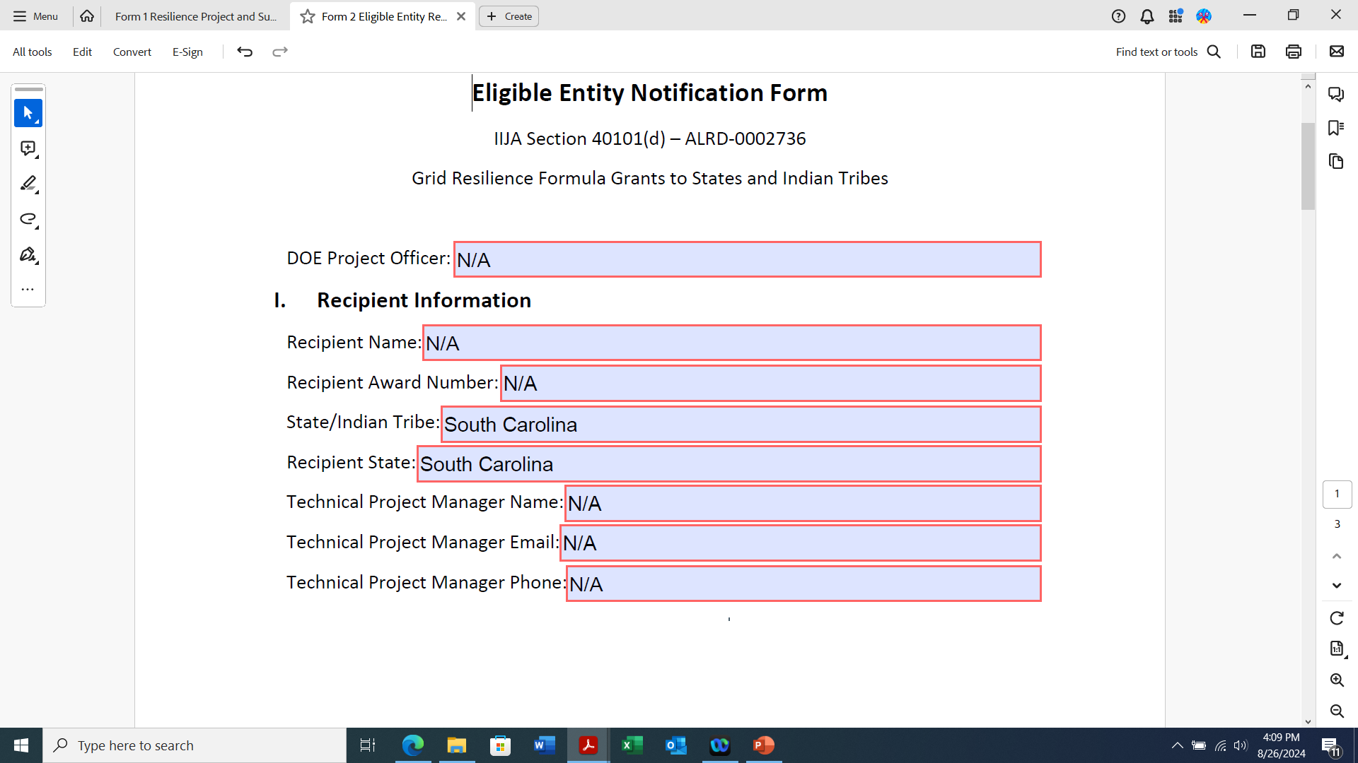
Form 2 - Secretarial Eligible Entity Designation Form
Santee Cooper is the Recipient.
Applicants do not fill in Section I.

Slide 17
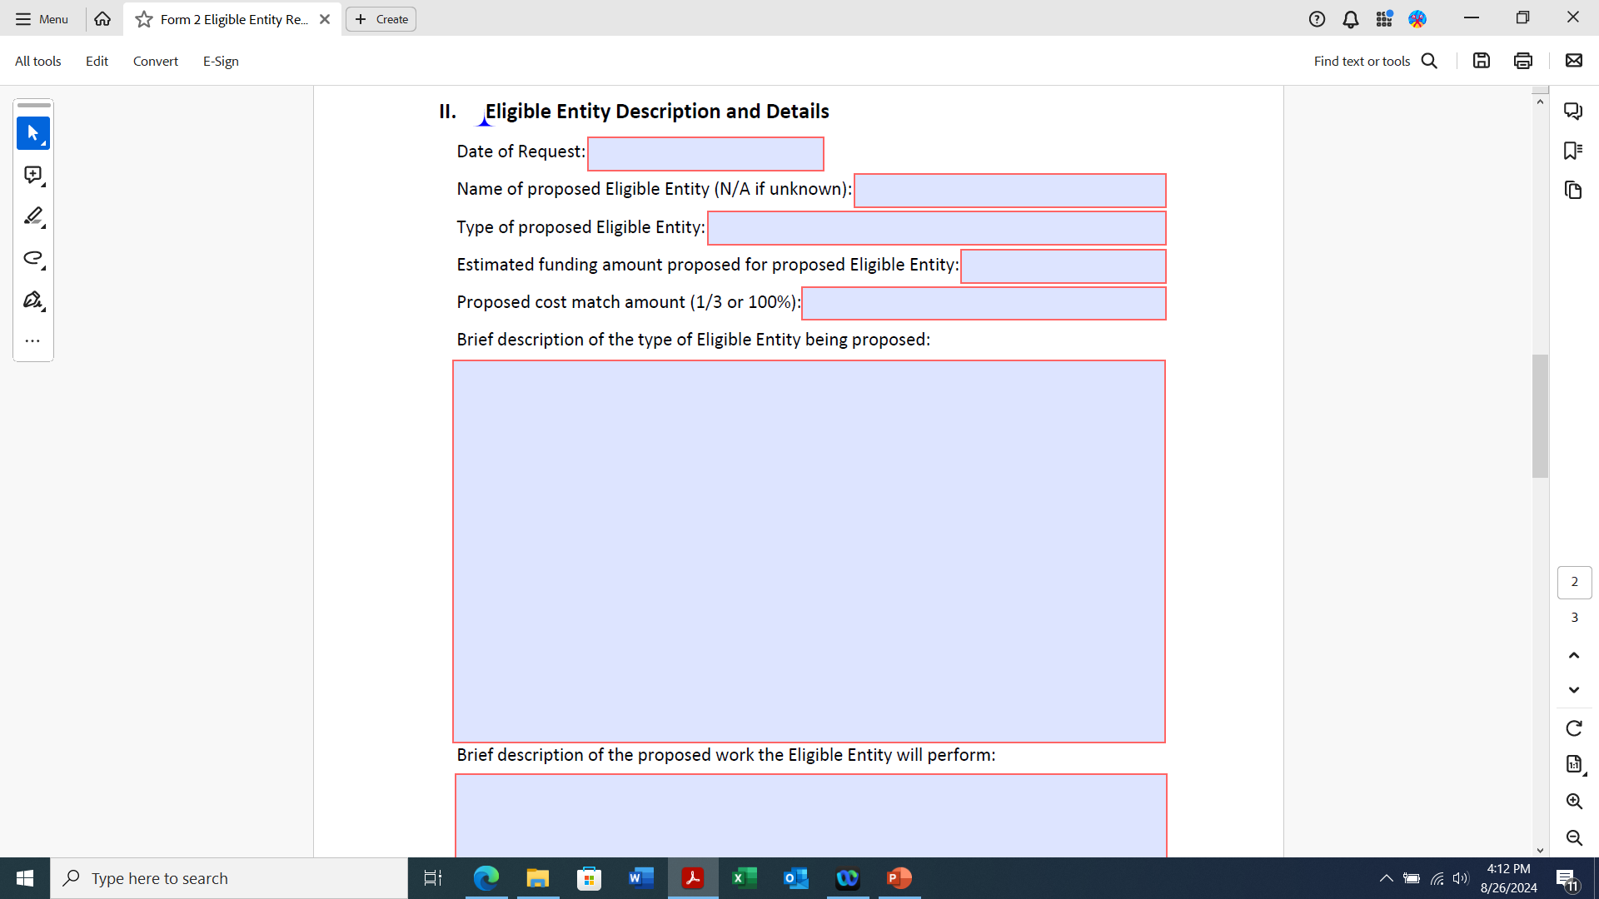
Form 2 - Section II
Applicant entity information.
You can use a summary of the description entered on Form 1.

Slide 18
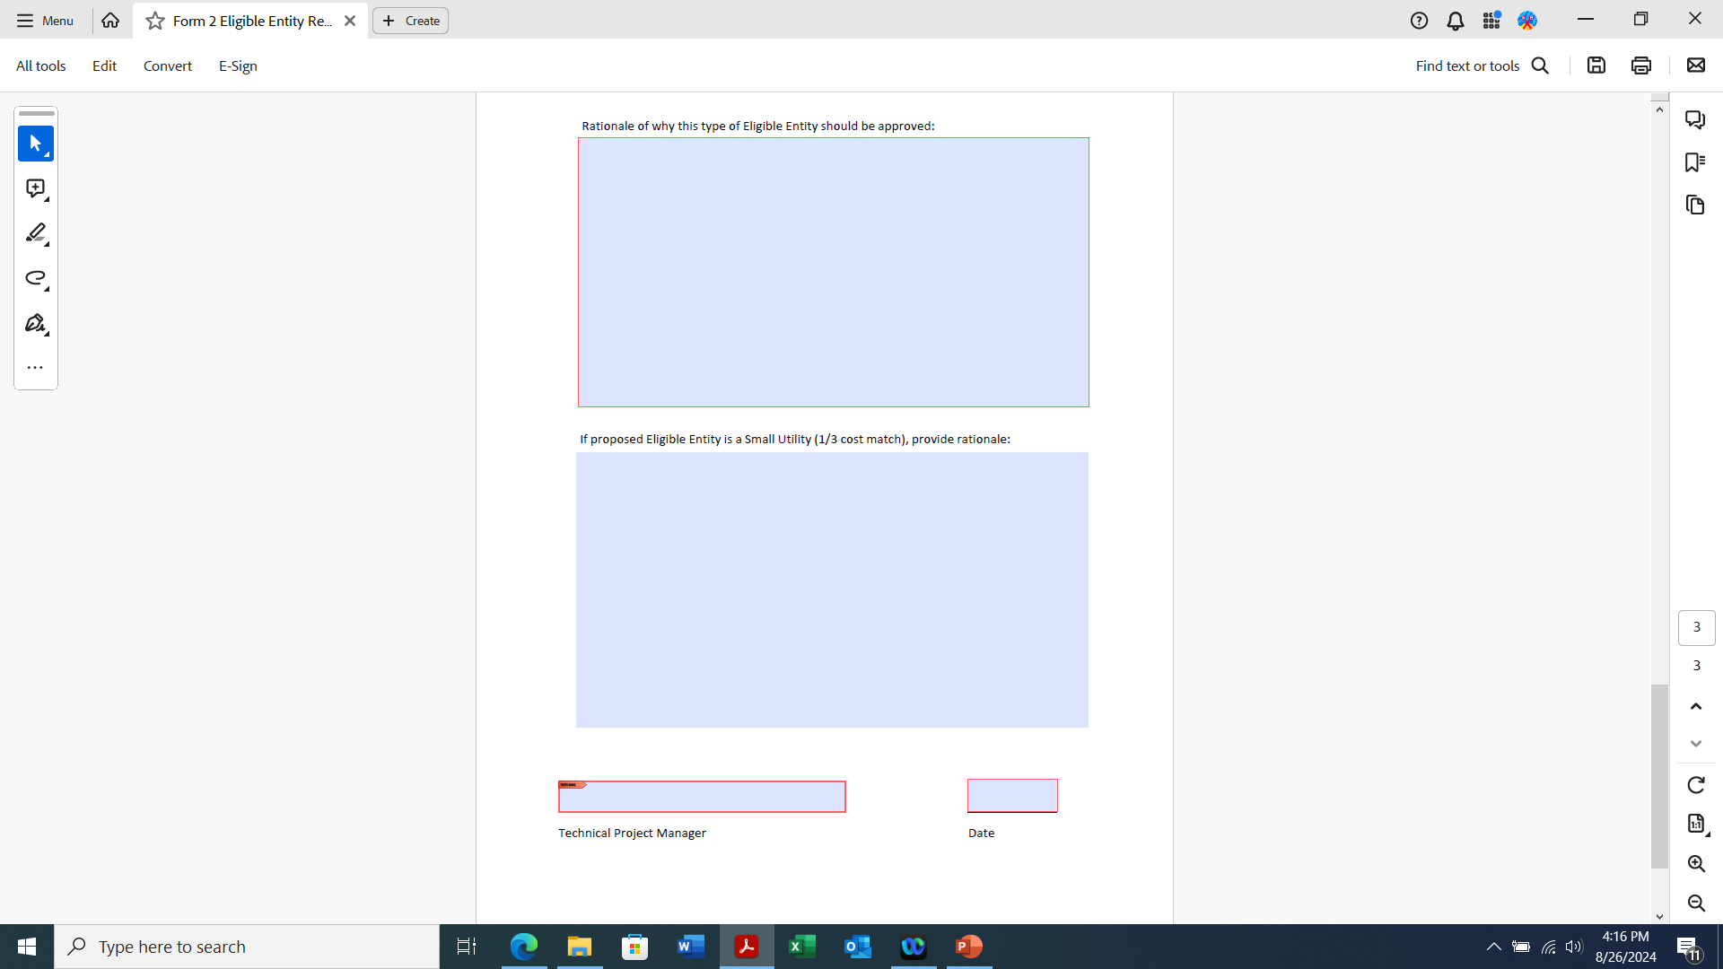
Form 2 - Section II
Small Utility = eligible entity that sells not more than 4,000,000 megawatt hours of electricity per year

Slide 19
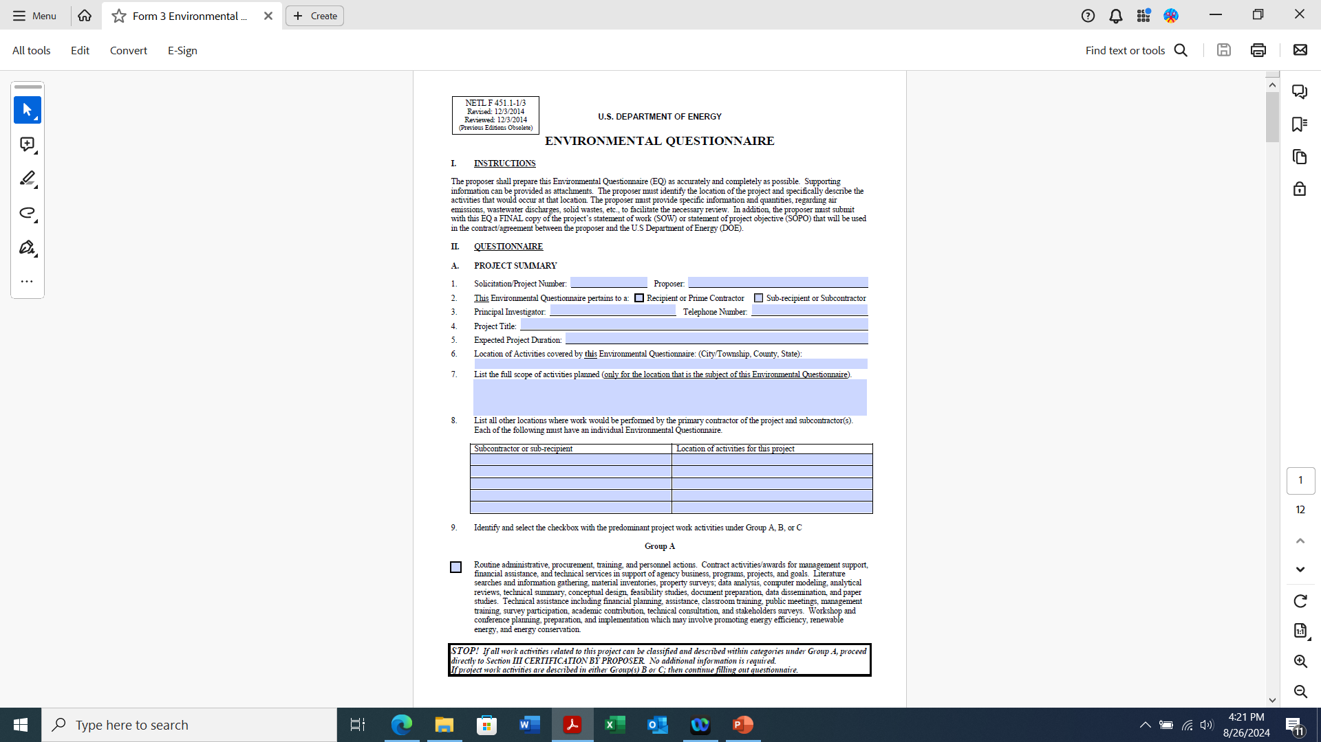
Form 3 - Environmental Questionnaire (NEPA)
Every question on this form must be answered.
Maps are required to be attached to this form.
Notes:
Stress the importance of answering every question. Explain how NEPA can delay the awarding of the funds.

Slide 20
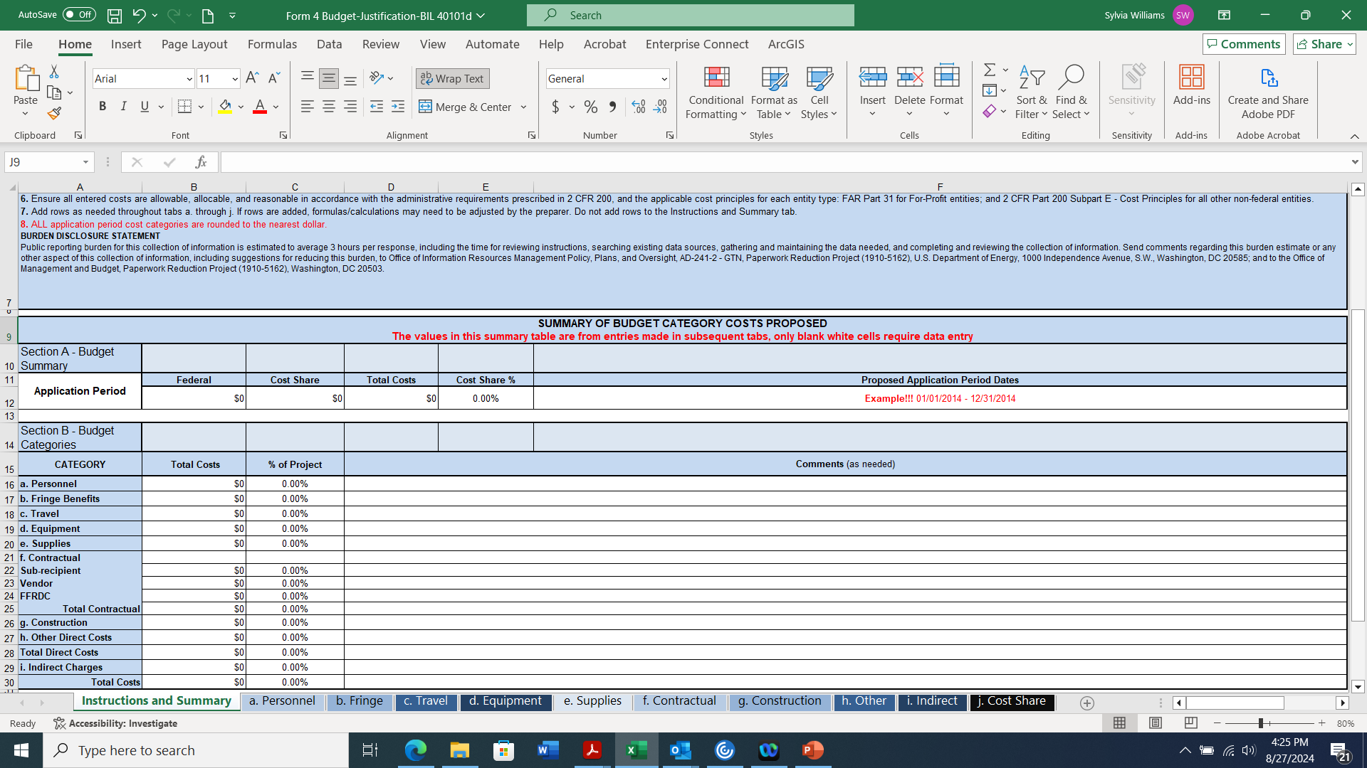
Form 4 - SF-242 Budget Justification Workbook
At the top of each tab are instructions for completing that tab.

Slide 21
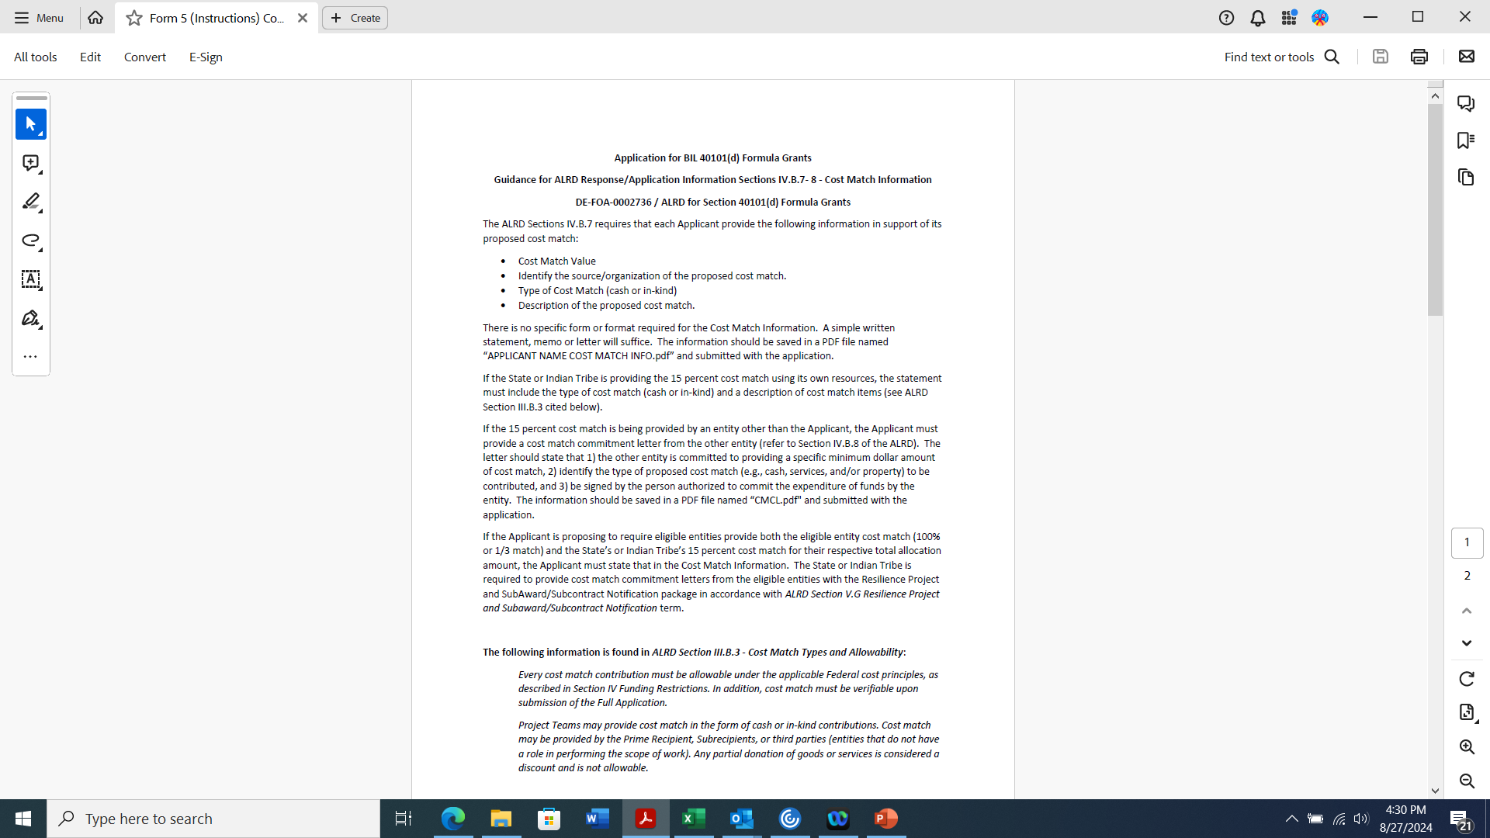
Form 5 - Cost Match Commitment Letter
Use these instruction to create your cost match commitment letter. Letter must be on the applicant’s letterhead.

Slide 22
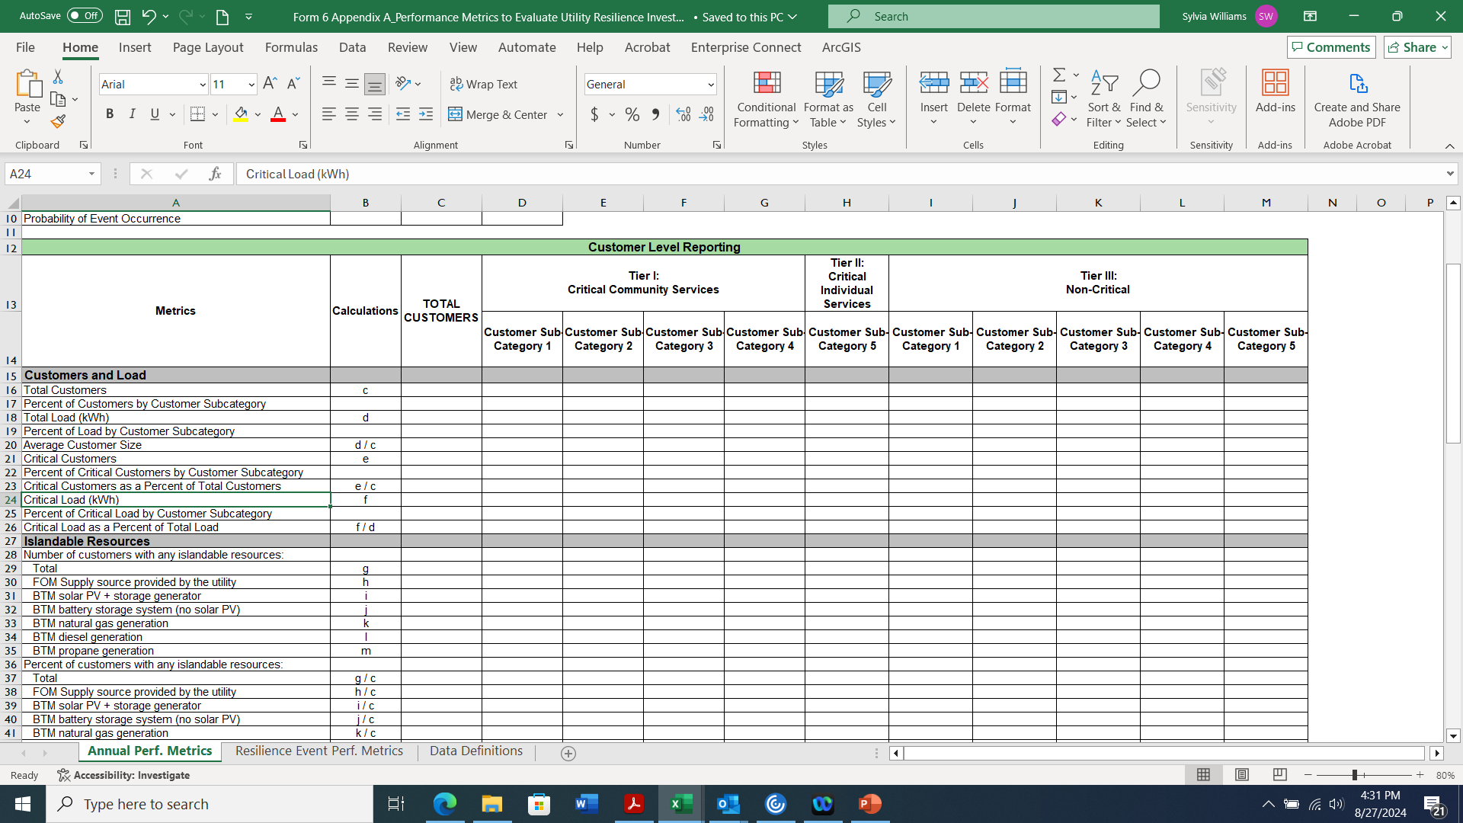
Form 6 - Appendix A-Performance Metrics to Evaluate Utility Resilience Investment
Refer to Appendix A-Instructions posted on the Grid Resilience Grant Program webpage to complete this form

Slide 23
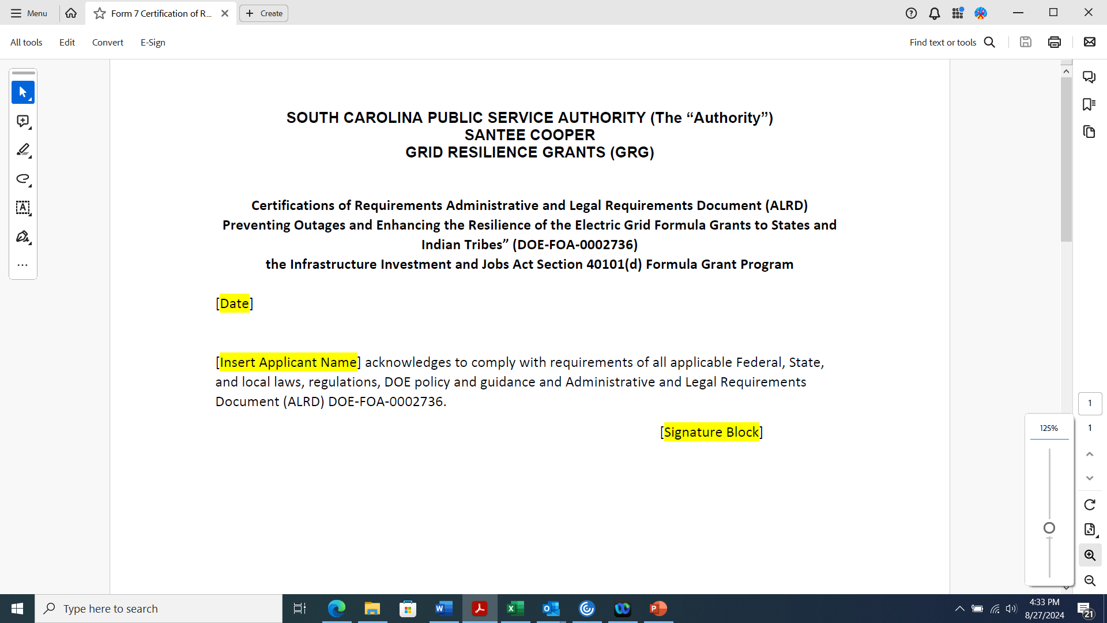
Form 7 - Acknowledgement of Federal Funds Governed by DE-FOA-0002736-certification Statement
Use this template to create your letter. Letter needs to be on the Applicant’s letterhead.

Slide 24
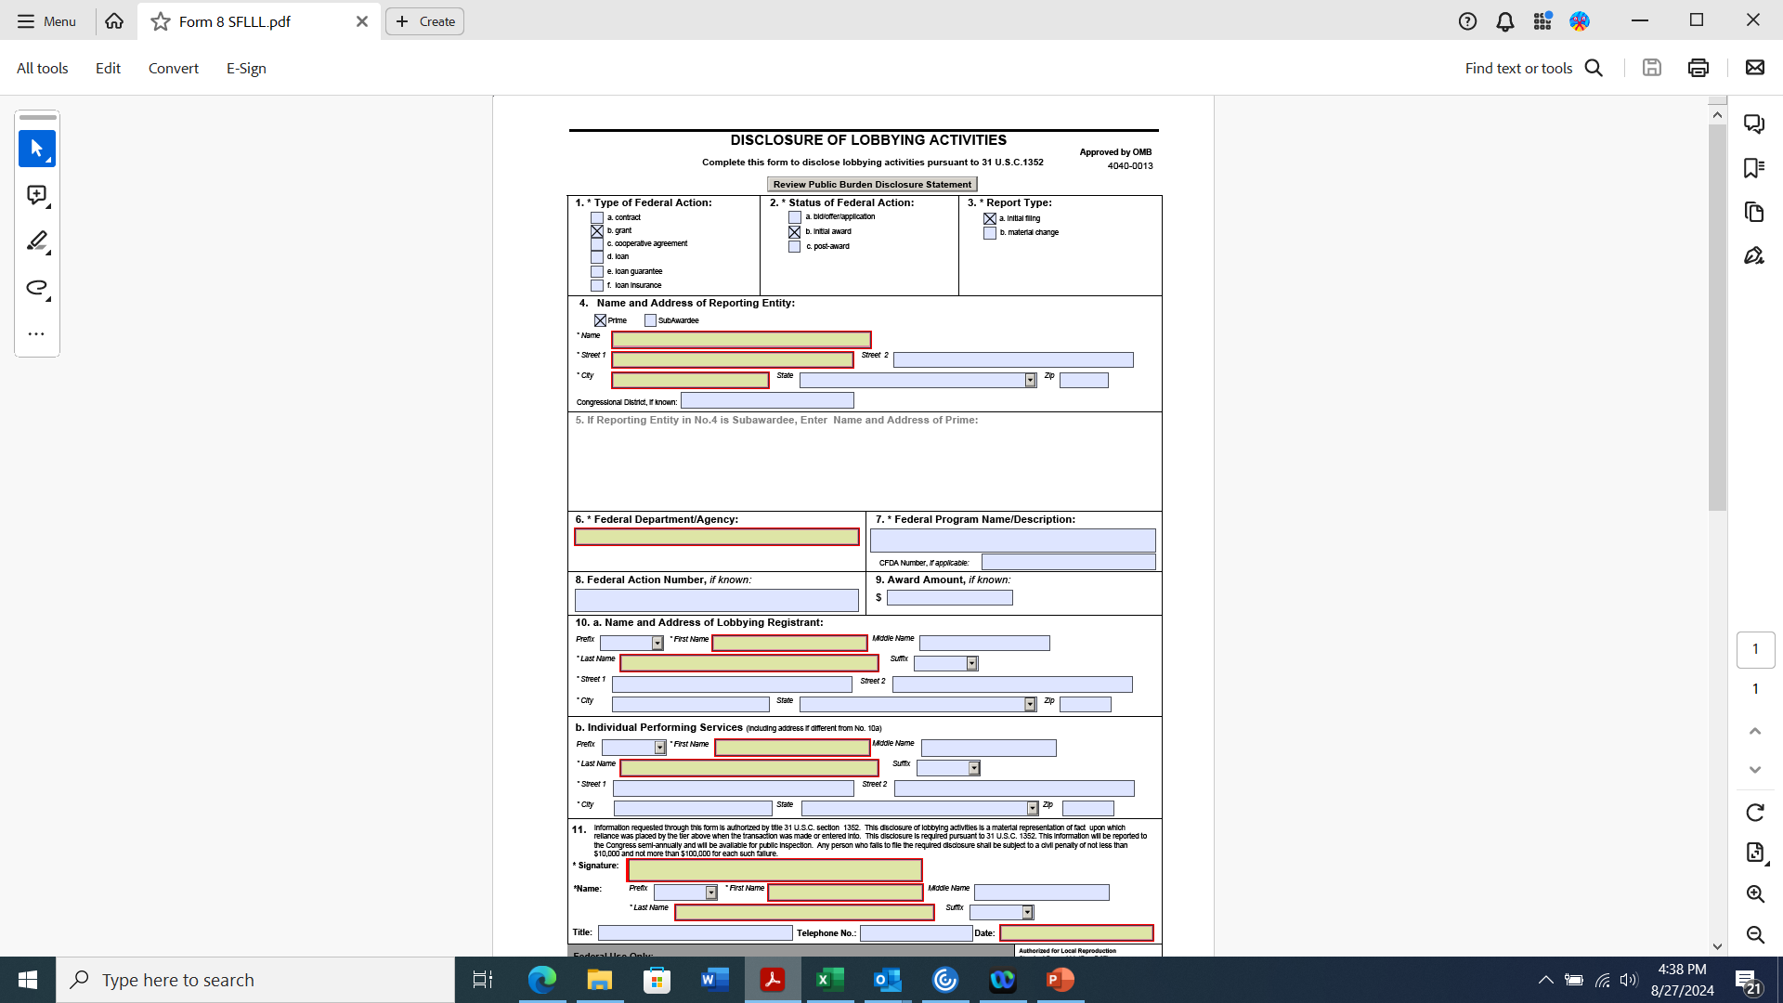
Form 8 - SF-LLL: Disclosure of Lobbying Activities

