Slide 1
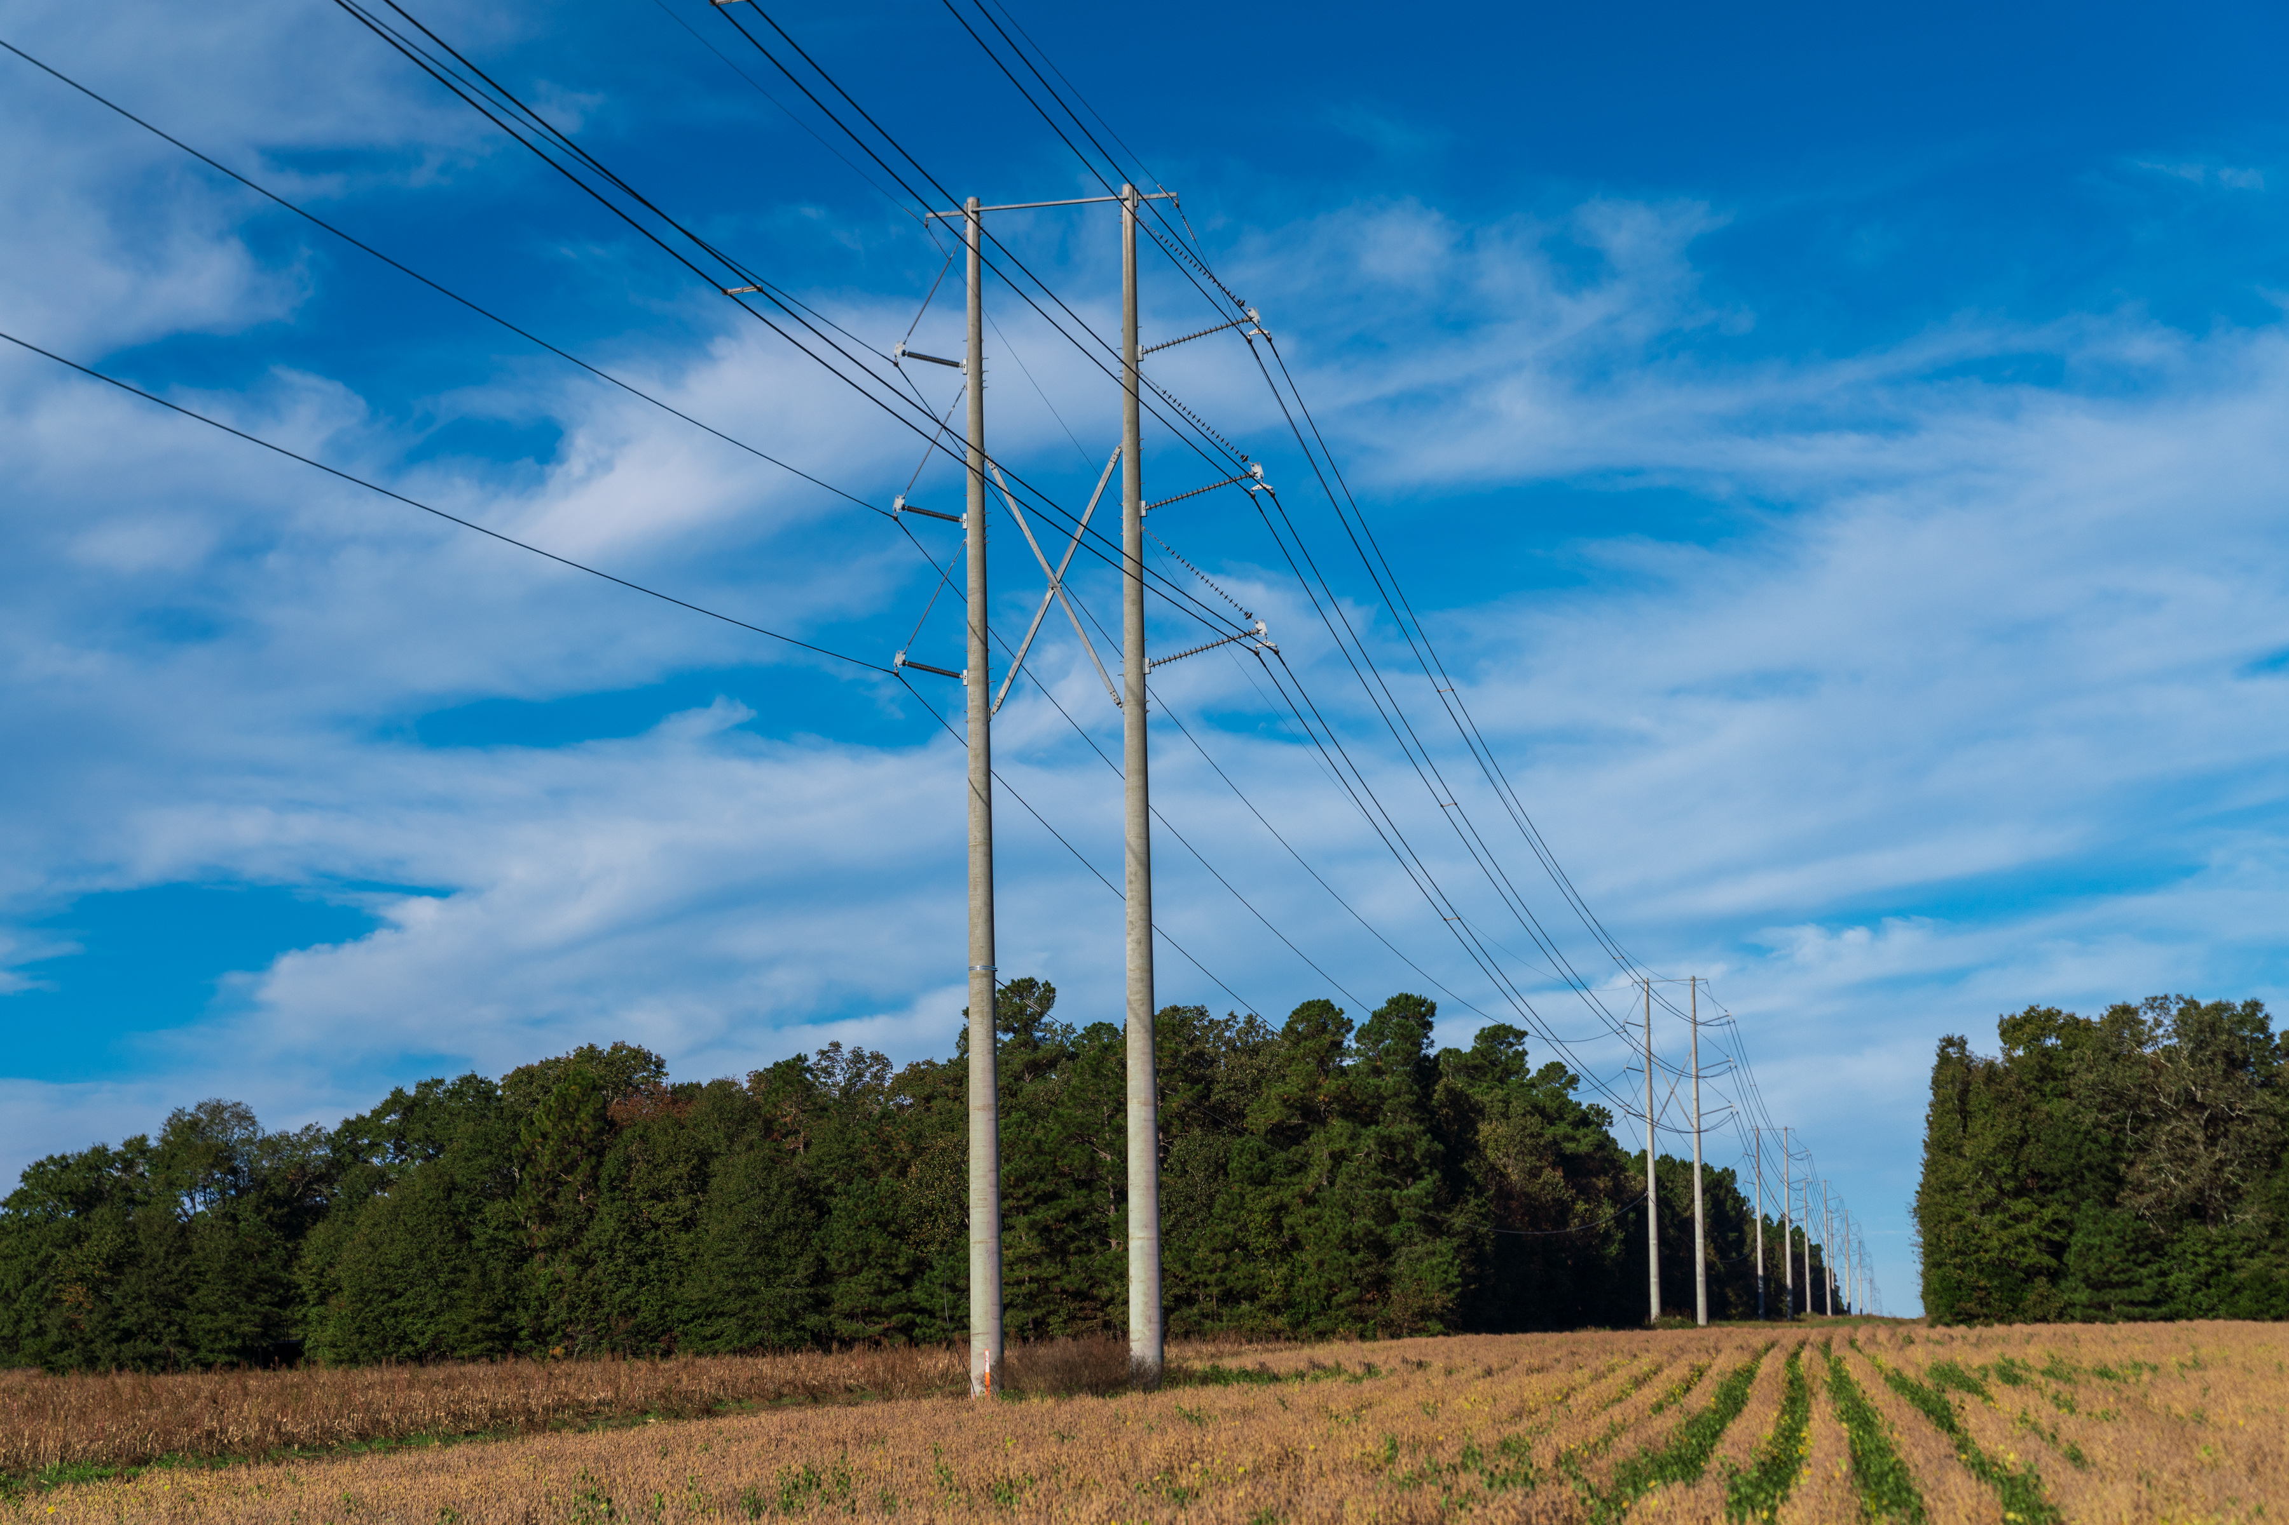
South Carolina Grid Resilience Grant Program --Post-Bid Information Session
September 7, 2023

Slide 2
Program Timeline
Activity | Date
Pre-Bid Learning Session | Aug 22
South Carolina RFP Open | Aug 24
Questions Due for Sept. 7th Session | Sep 5
Follow up RFP/Project Q&A Session | Sep 7
Eligible Entity Proposal Due | Sep 28
Initial Award Notice (Proposals sent to DOE for final sign-off) | Early Nov

Slide 3
South Carolina Grid Resilience Program
Santee Cooper soliciting energy co-ops, municipalities, local utilities, transmission owners/operators, and distribution providers to apply for funding to improve the resilience of electrical grid against disruptive events and address energy justice concerns
Project Prioritization & Evaluation
Preferred Projects
Improvement to Reliability and Resiliency: Reducing the number of outages or restoration times for extreme weather events
Community Benefits Plan: Demonstrating tangible impact to the community, the community population impacted, and the overall project cost in relation to overall impact
Project Definition and Information Available: Level of detail around project scope, budget/cost development, project partners, and timeline for implementation
Technological and Operational Complexity: Assessing the communications network, staffing plans, and organizational competencies for similar project types
Targeting Resiliency Improvements: Increasing Design Standards of Equipment (Projects which enhance the specifications and requirements for critical distribution equipment to improve system performance), Flooding Protection (Projects which offer protection against storm surge in coastal areas and inland flooding), DER Solutions (Projects incorporating FTM or BTM DER assets for residential and commercial customers)
Targeting Reliability Improvements: Sectionalizing Grid (Projects which protect the grid by isolating faulted sections from the rest of the distribution system), Adding Smart Technology (Projects which increase monitoring and control capabilities)

Slide 4

South Carolina Grid Resilience Program
BIL 40101(d) - Grid Resilience from disruptive events (i.e. weather and Act of God)
Santee Cooper application approved and funded May 23, 2023; Years 1 & 2 together
Total funding = $11,964,981
  Grant amt. $10,404,331 with 15% match of $1,560,650
Project Proposals awarded initially by Santee Cooper must be presented to DOE for final sign-off
Projects should contain realistic and verifiable metrics to show areas of impact and improvement (metrics and resources should be sourced from acceptable, industry standard sites or tools.)

Slide 5


RFP Documentation Requirements
DOCUMENTATION | REQUIREMENTS | FORMAT
Form 1 Resilience Project & Subaward Notification Form | Complete full form
Form 2 Secretarial Eligible Entity Designation Form | Complete full form
Form 3 Environmental Questionnaire (NEPA) | Complete full form
Form 4 SF-424 Budget Justification Workbook | Complete full form
Form 5 Cost match commitment letter | Complete full form
Form 6 Appendix A – Performance Metrics to Evaluate Utility Resilience Investments | As Applicable
Form 7 Acknowledgement of federal funds governed by DE-FOA-0002736 | Complete full form
Form 8 SF-LLL: Disclosure of Lobbying Activities (if applicable) | If Applicable
Form 9 Letters of Support (if applicable) | If Applicable
Appendix A – Performance Metrics to Evaluate Utility Resilience Investments

Slide 6
RFP Registration Requirements
PLEASE NOTE: Sub-awardees/sub-recipients must register (if not already registered) with the U.S. System for Award Management (“SAM”) and obtain a Unique Entity Identifier (“UEI”) from the SAM registration and provide the UEI on the application before the subaward can be issued. (The DOE will require this information on its review.)
SAM – Applicants for a Sub-award must register with the SAM at https://www.sam.gov/ prior to submitting an application (additional information can be found in the ALRD linked to the Santee Cooper website). As part of this process, the applicant will need to identify a Designating an Electronic Business Point of Contact (EBiz POC) and obtain a special password, called an MPIN, as important steps in SAM registration process. The applicant must maintain an active SAM registration with current information at all times throughout the completion of an awarded project.
UEI - Applicants must obtain an UEI from the SAM registration to uniquely identify the entity. The UEI is available in the SAM entity registration record.

Slide 7
RFP Documents – Question & Answer
Specific questions regarding process for completion of forms:
Form 1 Resilience Project and Subaward Form
  Do the .pdf fields that are labeled “N/A” need to be filled out by the applicant? The sections marked N/A do not need to be filled
  What do the subcontract sections mean? Would the applicant be the Sub-award or would that be for vendors/consultants that are helping with the grant proposal? Santee Cooper (behalf of SC) is the prime recipient/contract. The terms Subcontract/Subaward refer to the applicants and awards made through the RFP application.
  Number (iii)(A)(i). Please explain what you are looking for here. In this section identify if the applicant has submitted an application for FOA 2740, this is also known as GRIP Topic Area 1.
  Should we use the MWh sales number from the spreadsheet in Section (iii)(A)(iv) from 2021?
2. Form 3 – Environmental Questionnaire
  Please clarify what you require for section 6.a. Atmospheric Conditions/Air Quality. Please see instructions and resources identified in Form 3. Additional information can be found https://www.energy.gov/nepa
  Please clarify what you require for section 9.d. Identify and describe if a “Worker Safety Program” is in place and if so, describe.
3. Form 8 SF-LLL Disclosure of Lobbying Activities
a. Please clarify what you require for this section. Complete this form to disclose lobbying activities to ensure that non-federal funds have not been paid and will not be paid to any person for influencing or attempting to influence any of the following in connection with the application. This is only required if applicable.

Slide 8
RFP Documents – Question & Answer cont.
General Questions:
To whom should the letters of community support be addressed? Applicants may have these letters submitted with the full RFP application packet and letters may be addressed to “To Whom It May Concern” or “Santee Cooper Grid Resilience Grant Program Administrator”.
2. Regarding the “small entity set-aside” amount, how are applicants, including municipal entities identified as to whether they meet the “small entity” threshold? Entities with 4,000,000 MWh sales per year or less are considered “small entities.” Please refer to the ALRD for additional requirements set forth by the Department of Energy.
3. What is considered a Disadvantaged Community? As set forth by the Department of Energy on its general website:
“Justice40 directs that 40% of benefits from Covered Programs flow to “disadvantaged communities.” OMB’s Interim Implementation Guidance defines a community as either: (1) Geographic: a group of individuals living in geographic proximity (such as census tract), or (2) Common condition: a geographically dispersed set of individuals (such as migrant workers or Native Americans), where either type of group experiences common conditions. For the “geographic” definition of community, pursuant to the Interim Implementation Guidance and OMB guidance M-23-09, DOE recognizes as disadvantaged those census tracts identified by the White House Climate and Economic Justice Screening Tool (CEJST), which is located at https://screeningtool.geoplatform.gov/. For the “common condition” definition of community, federally recognized tribal lands and U.S. territories are categorized as disadvantaged in accordance with OMB’s Interim Implementation Guidance.”
4. Is there a minimum/maximum award amount that may be requested? No, the Department of Energy did not require or set standards for states to determine a minimum or maximum award amount.

Slide 9

RFP Review Process
Review consists of two steps to ensure an efficient and effective evaluation process for respondents
STEP 1: SCREENING CRITERIA
Is the application complete?
Does the response meet 1 of the 4 objectives?
Does the application meet workforce standards
STEP 2: PROPSAL EVALUATION CRITERIA
Evaluate the proposed improvements of the submitted projects and proposed metrics for tracking against a weighted scoring system
PROJECT RESILIENCY IMPACT (60%)
COMMUNITY BENEFIT IMPACT (40%)
Does the project demonstrate significant improvements to: Reduce the number of outages due to extreme weather events Improve the restoration times due to extreme weather events | Does the project demonstrate community benefits in any of key areas: Community population impacted beneficially Community and Labor Engagement Workforce Continuity and Good Jobs Plan: Diversity, Equity, Inclusion, and Accessibility (DEIA) Plan: Justice40 Initiative

Slide 10
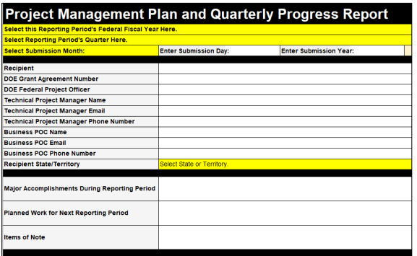
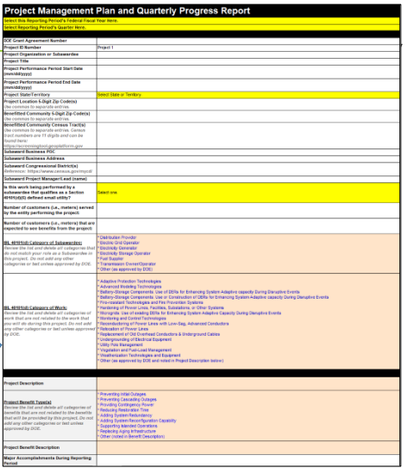
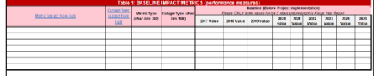
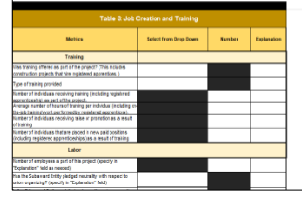
Dept. of Energy Reporting Requirements
Project Management Plan
Quarterly Reporting
Annual Report
Due 90 days after effective award date
Due 30 days after the end of each Quarter
Due 30 days after reporting year (October 1 – September 30)
Form-based response collecting information related to award, administration budget, customer impact, project milestones, contracts, impact metrics, overall and risks
Form-based report includes impacts (e.g., performance metrics), job creation, workforce demographics, and community engagements
Project-specific information and updates related to project build, resilience impact, and financial reporting
More information found at - https://netl.doe.gov/bilhub/grid-resilience/formula-grants/post-award-documents

Slide 11
RFP and Associated Documents
Next steps and where to find the RFP & Associated Documents:
RFP Opened for all eligible entities on August 24, 2023 and all proposed applications are due by 5:00 pm on September 28, 2023.
If you have additional questions following the information session on September 7, 2023, please submit all questions to gridresiliencegrant@santeecooper.com. Santee Cooper will provide an FAQ for such questions and answers related to general topics for all entities.
All proposed project applications should be sent to Santee Cooper at the following email address: gridresiliencegrant@santeecooper.com
  (Please clearly state in the subject line whether you are submitting a question or final application)
A recording of this information session, the RFP application and associated documents will be posted and made publicly available at: SanteeCooper.com/GridResilienceGrant
Additional information regarding the federal requirements and assistance can be found at https://netl.doe.gov/bilhub/grid-resilience/formula-grants/post-award-documents

