Slide 1
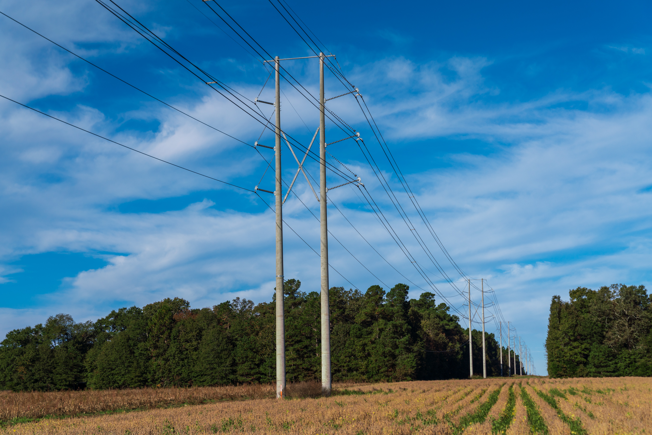
South Carolina Grid Resilience Grant Program --Post-Bid Information Session February 21, 2024

Slide 2
General Program Timeline
Activity | Date
Funding Year 1&2 Pre-Bid Learning Session | Aug 22, 2023
South Carolina RFP Open | Aug 24, 2023
Follow up RFP/Project Q&A Session | Sep 7, 2023
Eligible Entity Proposal Due | Sep 28, 2023
Initial Award Notice (Proposals sent to DOE for final sign-off) | December 2023
Funding Year 3 OPEN | Revised Program Narrative and Application due April 17, 2024

Slide 3
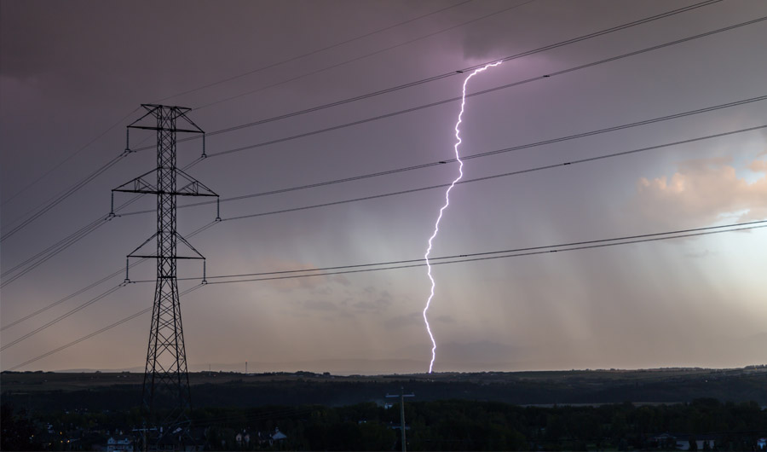
State of South Carolina Project Submission – Years 1&2 Funding Period FY 2022 & 2023
BIL 40101(d) - Grid Resilience from disruptive events (i.e. weather and Act of God)
Total funding = $11,964,981
Grant amt. $10,404,331 with 15% match of $1,560,650
18 Projects submitted and approved for a total federal funding request of $10,766,899 (retention amount addressed by DOE & NETL)
Applicants included 8 Cooperatives; 3 Municipal Power/Water Entities; and 1 Small Investor-owned Power Company
Individual projects expected to impact from 87,400 residents to roughly 100, depending on where the project is located

Slide 4
RFP Documentation Requirements
DOCUMENTATION | REQUIREMENTS | FORMAT
Form 1 Resilience Project & Subaward Notification Form | Complete full form
Form 2 Secretarial Eligible Entity Designation Form | Complete full form
Form 3 Environmental Questionnaire (NEPA) | Complete full form
Form 4 SF-424 Budget Justification Workbook | Complete full form
Form 5 Cost match commitment letter | Complete full form
Form 6 Appendix A – Performance Metrics to Evaluate Utility Resilience Investments | As Applicable
Form 7 Acknowledgement of federal funds governed by DE-FOA-0002736 | Complete full form
Form 8 SF-LLL: Disclosure of Lobbying Activities (if applicable) | If Applicable
Form 9 Letters of Support (if applicable) | If Applicable
Appendix A – Performance Metrics to Evaluate Utility Resilience Investments

Slide 5
Identification of DOE Calculation Issue
After the submission of the projects for review by the DOE (and due to the unique timing of the South Carolina submission), the Department of Energy and its consulting agencies identified a cost match discrepancy in the Budget Justification form that was originally created and posted by the DOE for reference. Unfortunately, the DOE and NETL partners were able to identify this issue after South Carolina had completed the applications and filed in December. The DOE website has since been updated with the correct Budget Justification form and calculation. This discrepancy caused a problem with the correct calculation of the amount each sub-awardee should recognize for its cost match requirement, resulting generally in a larger amount identified than was required. On the original form, the formula that was in the excel file originally calculated the cost share based off of the Total Cost of the Project, instead of calculating it off of the Federal Dollar amount that was being requested, which would then create the Total Cost of the Project. This resulted in each of the 18 applications (all qualifying for the small-utility sized match amount) exceeding the ALRD cost match requirement. However, this may also impact the proposed budgeted amount of the Total Cost of the project, depending on how each applicant originally made the determination for its project’s costs. This issue will not arise in future funding periods.
Santee Cooper wants to make each applicant aware of the discrepancy and then provide information to each applicant so there can be a review of the proposed project and applicants can determine the best way to address the discrepancy. Each applicant has a decision to make regarding each project, whether to (1) keep the Total Cost as originally set out, which may mean the sub-awardee would ultimately be responsible for more of a cost match than is federally required; or (2) calculate the correct amount of cost match based on the amount of federal funds being requested, which would most likely reduce the Total Cost amount of the project, which hopefully will not detrimentally affect the project scope.
Immediately after this call, Santee Cooper will provide a spreadsheet for each project submitted that sets forth these two options. Each applicant MUST review the applicable spreadsheet for the proposed project and make a decision on which option to choose and communicate that option back to Santee Cooper within one (1) week from the date of this communication (along with any required supplemental documentation ~ Forms 1, 4 & 5). Santee Cooper will then communicate these responses back to the DOE so that the budget reports will be accurate moving forward.

Slide 6
Sample Spreadsheet Calculations
As noted earlier, the original DOE workbook calculated the required cost match amount for a project as 1/3 of Total Project Cost; however, that requirement has been revised so that the required cost match amount should be calculated as 1/3 of Federal Funding Request (or 25% Total Project Cost). This is the minimum required amount, but an applicant can agree to a higher cost match percentage. Applicants have an opportunity to revise project budget based on updated form. The Federal Funding Request may not increase in budget revisions.
Option 1: Reduce Cost Match to 1/3 of Federal Funding Request and reduce presented Total Project Cost; Federal Funding Request remains the same. Applicant must submit revised Form 1, 4 and 5.
Option 2: Cost match amount, Total Project Cost and Federal Funding Request remain the same. Here, the applicant willingly exceeds the minimum cost match requirements. No revised documentation required – but affirmative confirmation is required.
Sample Calculations

Slide 7
Next Steps and Revised Documents
Next steps/Required response:
Immediately after the education session (held Feb. 21, 2024), each applicant will receive a spreadsheet specifically drafted for their proposed project(s).
Each applicant shall review the options available and make decision on how to proceed with any necessary revised forms.
Each applicant shall notify Santee Cooper directly no later than February 28, 2024 (one week from education session as to decision and revised forms.
Santee Cooper shall file revised options for each application with the Dept. of Energy, who will update and revise internally on various DOE reports.
If you have additional questions, please feel free to call Greg Edwards or submit all questions to gridresiliencegrant@santeecooper.com.
Santee Cooper continues to monitor and seek final information from the DOE regarding the overall status of the applications.

